Slide 1
Word count and duration | SB level | Articulate Slide mapping | Video slides mapping | Vector/ icon based | Marked Assessment? Id Yes, mention % for passing | No. of characters in VO
1696 | L3 | 41 | 26 | Vector based | - | 2 male

Slide 2

Introduction
Welcome to this module on Product Listing
Articulate
Start
Click Start to begin.
Notes:
Welcome to this module on Walmart’s Product Listing.
Click start to begin
GD note:
UI will be created and user will click start to begin

Slide 3



Introduction
How To List a New Product on Walmart
Video
Product Listing Policies and Parameters to Optimize Products
Notes:
VO:
This module will explain how a new product can be listed on the Walmart E-commerce page. It will also focus on the product listing policies and parameters to optimize the sellers’ products.
GD notes:
Animate the image in the background
@”explain” dhow the icons and text box as pop ups one by one in sync with the audio

Slide 4

Module Objectives
Understand product listing process in Walmart marketplace
Differentiate between good and bad product listing
Identify the key parameters to optimize the key parameters
New Slide
Notes:
VO:
By end of this module, you will be able to:
Understand product listing process in Walmart Marketplace
Identify the key parameters to optimize the key parameters
Differentiate between good and bad product listing
GD notes:
Animate and show the infographic in sync with the VO.
Ref id: 1011567406

Slide 5


Scenario
Video
Notes:
VO:
Michael is planning to start his first E-commerce venture with Walmart.
GD notes:
Have the backgorundof an e-commerce (yellow) icon and
@” Planning” show man thinking about his business
@ end of VO make the man fade away
Item ID: 378426421

Slide 6


Scenario
Video
Notes:
VO:
His friend John is in business for three years and Michael decides to seek John’s help to understand and clarify his doubts on E-commerce.
GD notes:
Insert the background
@” Friend” show an image of man on the RHS (John)
@”three” insert Michael on the LHS (Michael)

Slide 7
Scenario
Hey Michael! How are your doing? I’m happy to know about your new venture.
Video
Notes:
VO:
John: Hey Michael! How are your doing? I’m happy to know about your new venture
GD notes:
Retain the background
Animate the man on RHS to talk
Make him talk in sync with the VO
Animate man on LHS to move his head

Slide 8
Scenario
I’m good, thank you
John! I am here to get your help to sell my product on Walmart.
Video
Notes:
VO:
Michael: I’m good, thank you John! I am here to get your help to sell my product on Walmart.
GD notes:
Retain the background image
Animate man on LHS to talk in sync with the VO
Animate man on RHS to move his head

Slide 9
Scenario
More than happy to help you mate, what would you like to know about?
Video
Notes:
VO:
John: More than happy to help you mate, what would you like to know about?
GD notes:
Animate man on RHS to talk in sync with the VO

Slide 10
Scenario
Well, to begin with, can you please explain me how to list my product in the marketplace?
Video
Notes:
VO:
Michael: Well, to begin with, can you please explain me how to list my product in the marketplace?
GD notes:
Retain the background
Make the man on the LHS to talk in sync with the VO

Slide 11
Scenario
Sure Michael, I’ll surely explain all the details about product listing.
Video
Notes:
VO:
John: Sure Michael, I’ll surely explain all the details about product listing.
GD notes:
Make the man on the RHS to talk in sync with the VO

Slide 12


Product Listing on Walmart
Video
Product Listing page is the first opportunity for a product to interact/impress customers
Notes:
VO:
Many online shoppers search for product information before making purchases and a product listing page is the first opportunity for a product to interact with—and impress—a potential customer.
GD notes:
@” online shoppers” display the group of people on the LHS
Animate them like waving
@”product listing page” display the laptop screen with list of products

Slide 13
Product Listing on Walmart
Video
Notes:
VO:
Let us look at some of the points to list your products on the Walmart Marketplace.
GD note:
@” let us” bring in John on the RHS of screen and make him talk as per the VO
Animate man on the LHS to move his head like listening

Slide 14


Product Listing on Walmart
Articulate
OST Added
Create a new listing to sell your own products
Notes:
VO:
When you sell your own product/s, you will have to create a new listing. This means that you are the first seller to sell that product in the Walmart Marketplace.
GD notes:
@” sell” place an image of man and animate him like thinking
@”means” display a bubble over his head and insert the laptop image

Slide 15



Product Llisting on Walmart
Articulate
Multiple merchants selling the same product share a common listing
Notes:
VO:
When there are multiple merchants selling the same product that you are, you will be sharing a common listing. You should use the same and need not create a new list.
GD notes:
@multiple e-commerce sellers, display the
@” when” display the image of man
Make him talk as per the VO.

Slide 16

Product Listing on Walmart
Select the product category
Articulate
Subcategorize the item
Notes:
VO:
Select the product category and subcategorize to classify the item which you want to sell.
GD notes:
@”category” display the image of various product categories

Slide 17



Product Listing on Walmart
How have the others done it?
Video
Notes:
VO:
If you think that your product can be listed in multiple categories, look at how the other sellers have categorized their products.
GD notes:
Use the same man on LHS and RHS
@” product” insert the image of man thinking on the LHS
On the RHS @” other” display image of man looking at the laptop and display a callout saying:” How have the others done it?”

Slide 18

Product Listing on Walmart
Video
Fill the product listing’s information
Notes:
VO:
Once you choose the appropriate category, you will be enabled to fill the product listing’s information
GD notes:
@once you choose, fade in the image along with John’s image
Display the OST over the man @” fill ”

Slide 19

Product Listing on Walmart
Product Title
Product Description
Articulate
Images
Notes:
VO:
You will be asked to fill in the product title, product description, and images. This is the most crucial part in listing your product.
GD notes:
Display the infographic @” Asked” and insert the text in sync with VO

Slide 20


Product Listing on Walmart
Articulate
Product details should be convincing the buyers to purchase
OST Added
Engaging
Informative
Notes:
VO:
The details that you provide should be engaging and informative at the same time. Most importantly, it should be convincing enough for the buyers to purchase your products.
GD notes:
@” engaging and informative” display the image and the text box one after the other
@Most important, fade in image 2
@”buyers” show the group on the RHS

Slide 21

Key Parameters to Optimize Product Listing
Product Review
Category Mapping
Articulate
Product Listing Parameters
Product Description
Variant Listing
Number of Product Images
Product Title
Key parameters for product listing
Notes:
VO:
Some of the key parameters to optimize your product listing are:
Category Mapping
Variant Listing
Number of Product Images
Product Title
Product Description
Product Review
GD notes:
Insert an infographic
Insert the text box in clockwise manner
Animate the arrows to point towards the center

Slide 22



Key Parameters to Optimize Product Listing
Articulate
OST Added
Map the product type with the correct category on Walmart
Notes:
VO:
It is important to map the product type from your online store with the correct category on Walmart.
GD notes:
Show in computer on Walmart page
@product type display the images on the LHS of the screen
@”correct category” display the image on the RHS with an arrow
Display a incorrect sign on the RHS image

Slide 23



Key Parameters to Optimize Product Listing
Articulate
Electronics
OST Added
Do category mapping for the products
Notes:
VO:
When you add a new product type in your Walmart store, you also need to do category mapping for the products you want to sell on Walmart.
GD notes:
Show in computer on Walmart page
@” new product” display the images one after the other
@”mapping” display the text box on the RHS and insert the arrow.

Slide 24
Key Parameters to Optimize Product Listing
Clothing
Articulate
Electronics
Set the products in the right category to reach customers
Notes:
VO:
For example when you are selling clothing type products, select “Clothing” as the main category and the “clothing” as the sub category.
Setting your products in the right category will ensure that the customers can search them easily.
GD notes:
Show in computer on Walmart page
@” products” display the clothes and the electronic devices image on the LHS of the screen
@” category” display the text box with the arrow on the RHS

Slide 25

Key Parameters to Optimize Product Listing
Articulate
Factors
Click to view the parameters.
Notes:
VO:
Click the factors button to view the parameters that can break or boost the process of Marketplace product listing.
GD note:
@”factors” display the image and make people in the image to move
@parameters create a UI and user will be able to use the Factors button

Slide 26

Key Parameters to Optimize Product Listing
Bullet points structuring
Bullet points structuring
How well the product description is given
Number of characters used in the title of the product
Number of characters used in the title of the product
Articulate
Number of images that have been uploaded
Number of reviews and ratings given for the product
Number of images that have been uploaded
Number of reviews and ratings given for the product
Notes:
VO:
Keywords that are used:
Number of images that have been uploaded
Number of characters used in the title of the product
Bullet points structuring
How well the product description is given
Number of reviews and ratings given for the product
GD note:
@Keywords animate the image
@Fade in the OST one by one in sync with the audio
Animate the bullets in such a way that it should appear from the microscope

Slide 27


Variant Listing
Articulate
Notes:
VO:
Variants are usually in a product. People might prefer a different colour of your product and will really appreciate if your offer them a fair number of choices.
GD notes:
Show in computer on Walmart page
@” variants” display a person using a laptop screen
@” prefer” zoom in on the screen
@” really” display the t-shirts one after the other

Slide 28
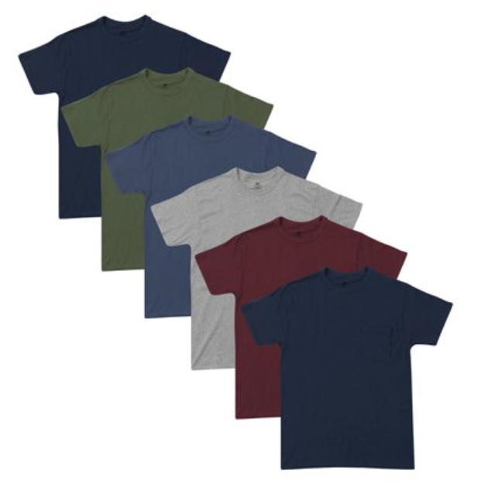

Variant Listing
Articulate
Single Blue T-shirt
T-shirt Collection
OST Added
Product variants must be grouped together
Notes:
VO:
If you have variants in your product, instead of listing them individually, group them together.
GD note:
Show in computer on Walmart page
@”variant” display a single t-shirt on the LHS of the screen
@” individually” show the image of t-shirt collection on the RHS of the screen

Slide 29


Variant Listing
Articulate
OST Added
Provide one-stop-shop’ with a multitude of options
Notes:
VO:
Always remember that nothing works better than a ‘one-stop-shop’ with a multitude of options.
GD notes:
@” one stop shop” insert the icons one after the other and make them float.

Slide 30

Number of Product Images
Articulate
OST Added
Use high quality images on the website
Notes:
VO:
A lot of customers are attracted to high quality images of the products listed on the website.
GD notes:
Show good quality images on Walmart page.

Slide 31
Number of Product Images
Is that true ? I didn’t know about this.
Do you know that customers are attracted to images?
Articulate
Notes:
VO:
These images will give them a better perspective of how it might look like and is a sure way to attract customers.
GD notes:
Animate the two men in the image like having a conversation
Man on the RHS should make gestures and man on LHS should nod his head
Display a callout for the man in RHS in sync with the VO
Display a callout for the man in LHS in sync with the VO

Slide 32
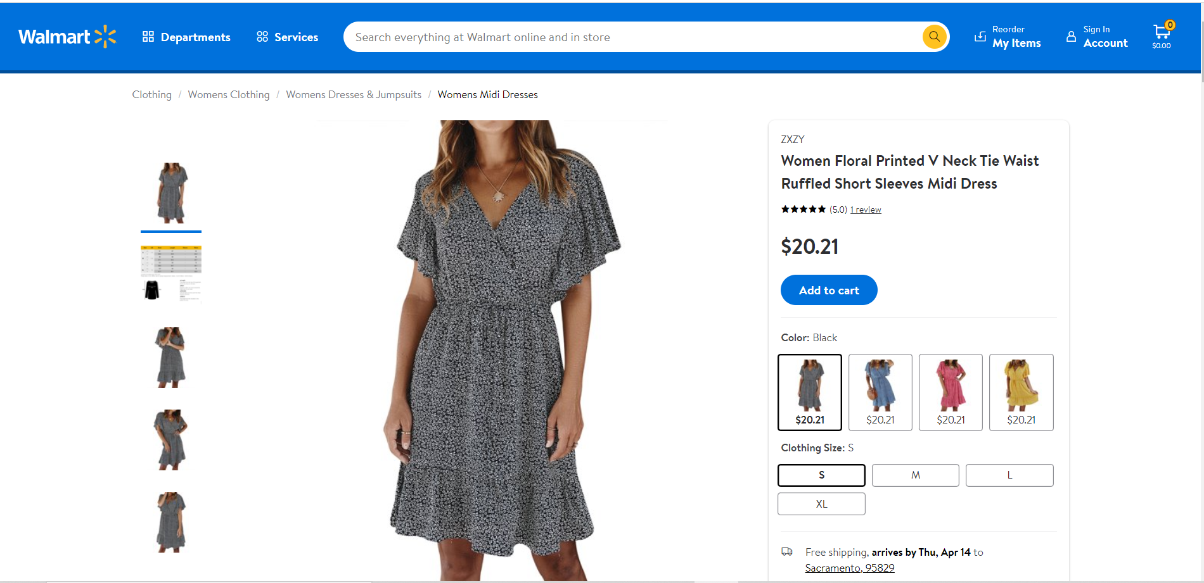
Number of Product Images
Articulate
OST Added
Provide three or more images of your product
Notes:
VO:
When posting image of your product, make sure you have these three images:
GD notes:
Show Walmart page on a computer.

Slide 33
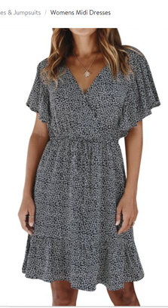
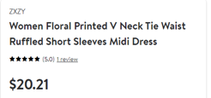
Number of Product Images
Articulate
OST Added
Main image: Showcasing your product in full form
Notes:
VO:
Main image: Showcasing your product in full form
GD note:
Show Walmart page on a computer.

Slide 34
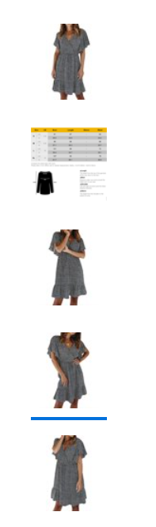
Number of Product Images
Articulate
Additional image: Showcasing the various angles of the product
OST Added
Notes:
VO:
Additional image: Showcasing the various angles of the product, specific closeups if any details present
GD note:
Show Walmart page on a computer.
@” various angles” show the images from various angles.
view the image one after the other

Slide 35
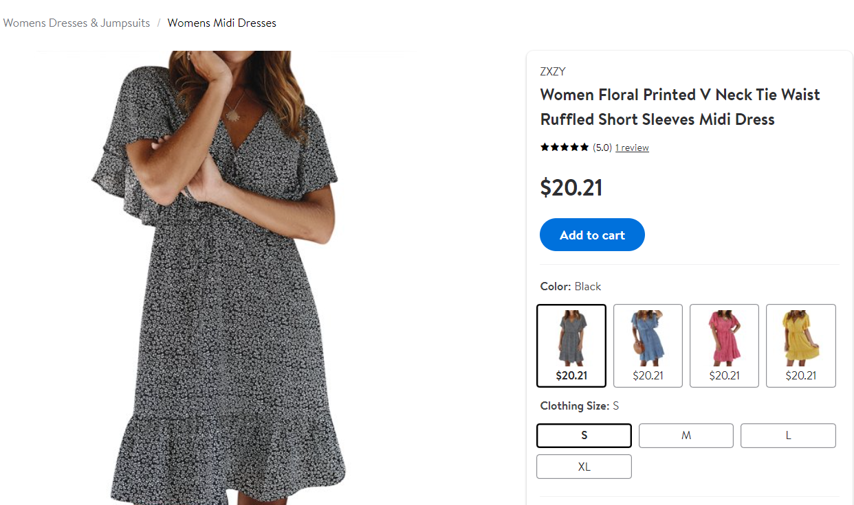
Number of Product Images
Articulate
OST Added
Swatch image: If there are variations in the product like colour, add them
Notes:
VO:
Swatch image: If there are variations in the product like colour, add them as well.
GD note:
Show Walmart page on a computer.
@” swatch image” view the image of the t-shirt
@” variations” highlight the different colours or t-shirt using a circle.

Slide 36
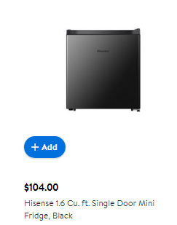
Number of Product Images
Articulate
Ensure your main images are on a clear, white background
OST Added
Notes:
VO:
Ensure your main images are on a clear, white background, however other images are on a clean and simple background.
GD note:
@” main image” display the picture of the product with a white background
@hover

Slide 37
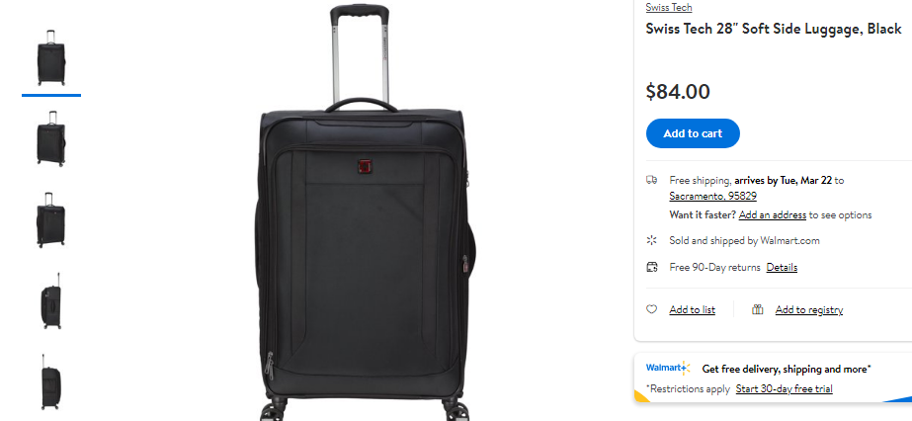
Number of Product Images
Articulate
Notes:
VO:
Most of the top listings have 5 to 8 photos. However, adding 6 images are considered the sweet spot.
GD notes:
@”top listings” insert the image of the product page
@” images” highlight the photos on the side of the product .

Slide 38
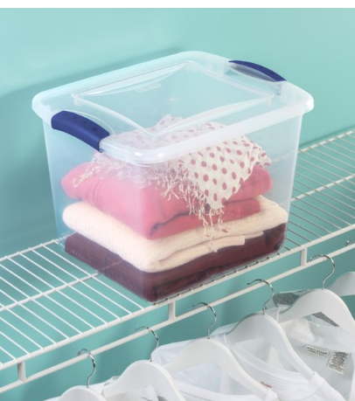
Number of Product Images
Articulate
OST Added
Use lifestyle images to better understanding of the products and its features
Notes:
VO:
You can also use lifestyle images to provide a better understanding of the product and its features.
GD notes:
@” lifestyle image” display the image on the screen

Slide 39




Product Title
short
Video
concrete
Define in one line
Notes:
VO:
The title you choose for your product must be short, concrete and must define the product in one line. If you are not sure on giving one, look at the titles of the top listed products. Make sure you do not copy it.
GD note:
Show and animate the image.
And show the OST in sync with the VO
Ref id: 2015362289

Slide 40



Product title
PRODUCT NAME
Video
OST Added
Create own title
Notes:
VO:
Take ideas from each one and create your own title. The title should convey what the product and brand are, how it is used and mention quantities if required.
GD notes:
1. Show and animate the image as the woman getting an idea, and the bulb appears.
2. @convey what…. Show the question mark
3. @mention quantities….. Show and highlight the cardboard boxes and marker icon
Ref id: 2113853303

Slide 41
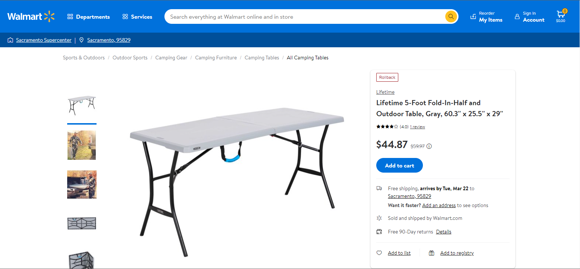
Product title
Articulate
Notes:
VO:
Let us look at the basic structure of a product title.
Brand+ Item Name+ Model Name (If applicable) + Style (If applicable) + Key attribute+ Quantity (if applicable) + Size (if applicable) + Colour (if options are present).
GD notes:
@brand…… highlight ‘lifetime’
@item name…. Highlight the word ‘outdoor table’
@style…. Highlight the word 5 foot
@key attribute… highlight the word ‘fold in half’
@size….. Highlight the size
@color…. Highlight the word ‘gray’

Slide 42

Product title
Product title
Video
OST Added
Length of the product title affects the sales.
Notes:
VO:
A study was considered on how the length of the product title affects the sales.
Surprisingly, there was an established relationship between these two factors.
GD notes:
Show and animate the image
Ref id: 2015362289
“Walmart will…. Show the dummy webpage, and highlight the five dotted line

Slide 43
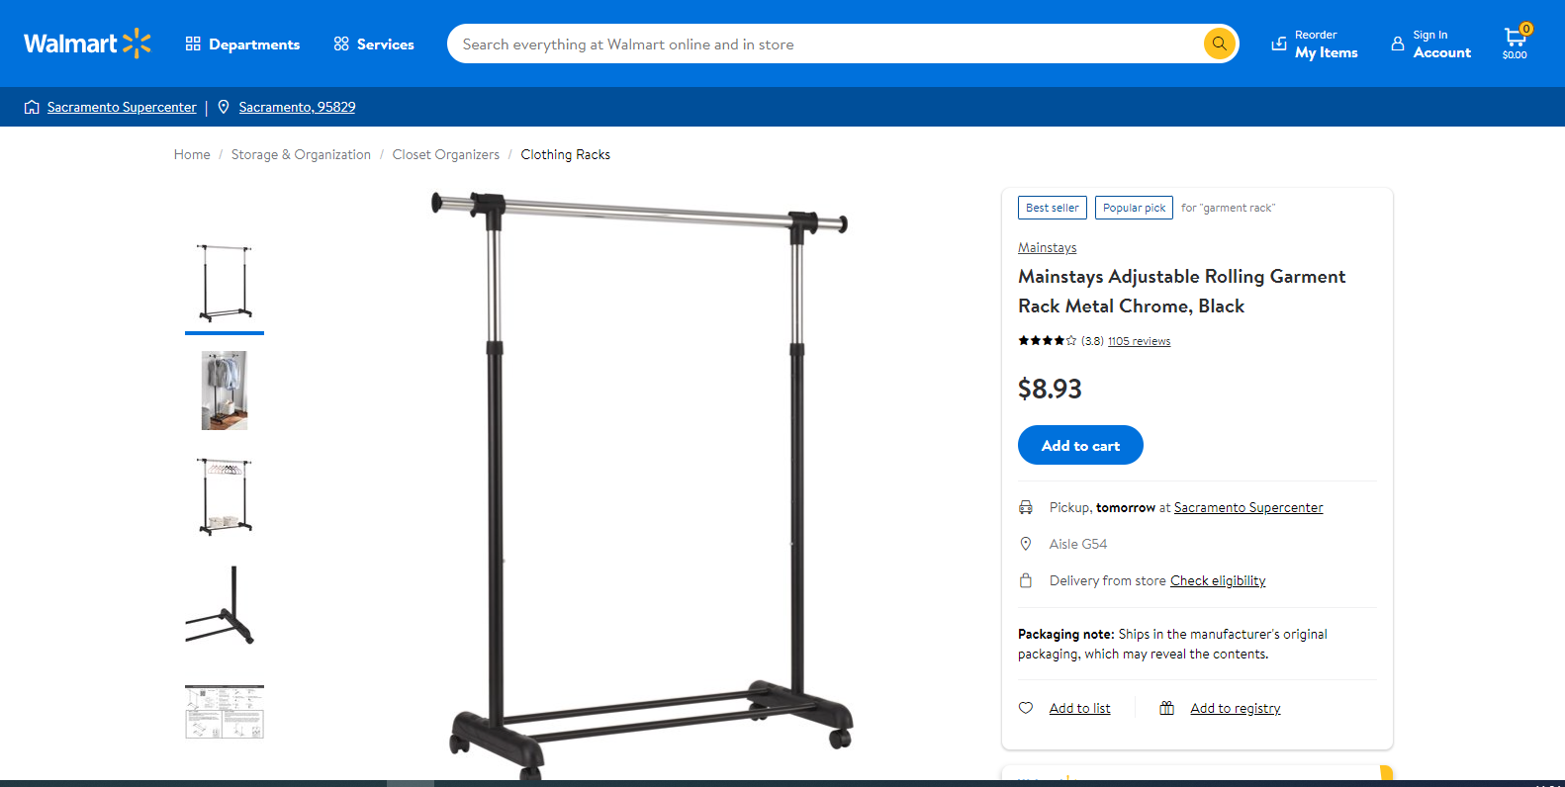
Product title
Articulate
OST Added
First five words explain 80% of the title
Do’s
Notes:
VO notes:
Walmart will consider the first five words when creating a website link for the product. So make sure first five words explain 80% of the title.
Click on the Do’s button to optimize your product listing title.
GD notes:
1. Show the image in a computer screen
2. @five words……. Underline the five words
3. Make the ‘Do’s’ as clickable
Redirect to next slide

Slide 44
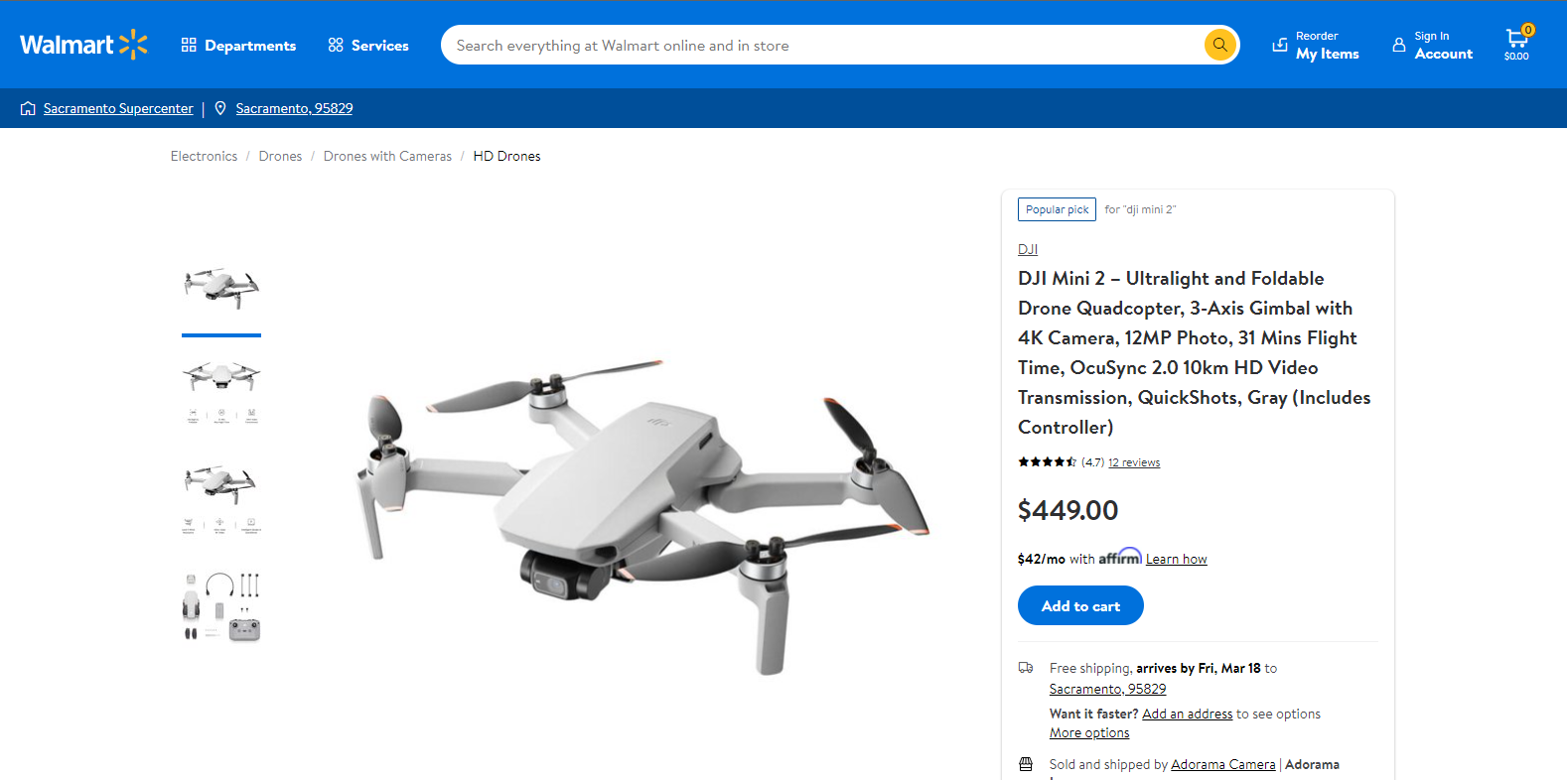
Product title
Articulate
OST Added
Character limit: 100-150 characters
Notes:
VO:
Your title should contain at least 80 characters. To provide a better user experience, make sure the character limit ranges from 100-150 characters
GD note:
Show the image and highlight the area

Slide 45
Product title
Articulate
OST Added
Include potential keywords
Notes:
VO notes:
Include potential keywords and include (-) or (|) to make them easier to read
GD notes:
Highlight ‘Mini 2- Ultralight’ and ‘3-axis’

Slide 46
Product title
Articulate
OST Added
Include colour, model number, series, and quantity
Notes:
VO notes:
Include colour, model number, series, and quantity (if required)
GD notes:
Show the image
@colour… highlight ‘Gray’
@model number…. Highlight Mini 2

Slide 47
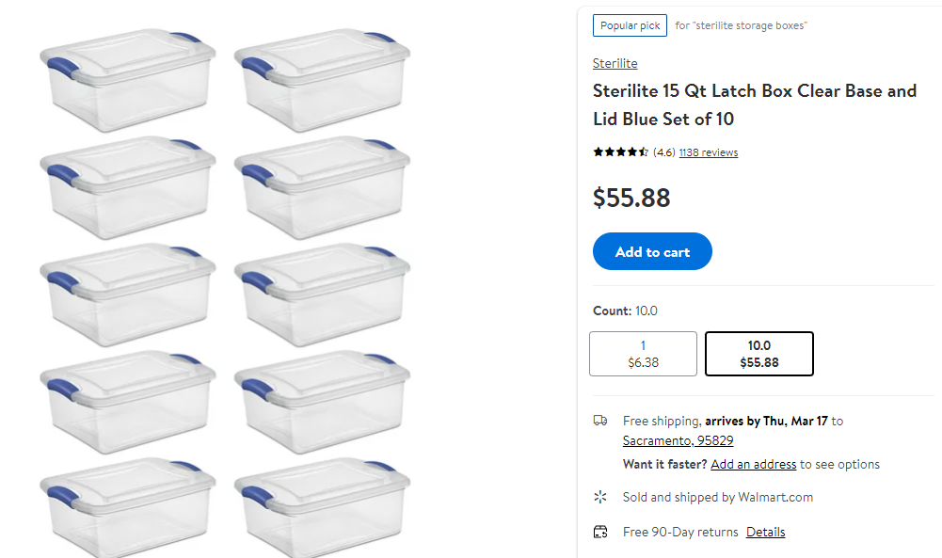
Product title
Articulate
OST Added
If the product is a multipack, mention the quantity
Notes:
VO notes:
If the product is a multipack, mention the quantity. Example: 10-pack, set of 5 etc
GD notes:
Show image and highlight the area

Slide 48

Product title
Articulate
Subjective adjective like amazing, fantastic
Special characters like @ $ or too much information.
Notes:
VO notes:
Avoid subjective adjective like amazing, fantastic etc, special characters like @ $ or too much information.
GD notes:
Retain the previous screen as bg, and show the OST in sync with the VO

Slide 49
Product description
Articulate
Avoid fake attributes
Do’s
Notes:
VO:
When giving a description of your product, make sure to include key features and benefits of your products or services. Do not make too many promises or list fake attributes. Make sure the top three points cover the important selling points of your product. 250 words is the ideal length.
Click the Do’s button to optimize your product listing description
GD notes:
Show the image
@features…… underline the area as shown above
@many promises…. Show the avoid symbol and show the OST

Slide 50


Product description
Keep it short, clear and precise
Don’t use subjective terms like “hot selling this year, great value,”
Give descriptive and factual information
Articulate
Do not add promotional information
Highlight the key features
Do not add email or web addresses
Check for grammatical and spelling errors
Do not mention any contact information
Include colour, size and compatibility information
Notes:
VO:
Keep it short, clear, and precise
Give descriptive and factual information
Highlight the key features
Check for grammatical and spelling errors
Include colour, size, and compatibility information
Don’t use subjective terms like “hot-selling this year, great value, etc.”
Do not add promotional information
Do not add email or web addresses
Do not mention any contact information
GD notes:
Blur the bg, and show the OST in sync with the VO

Slide 51
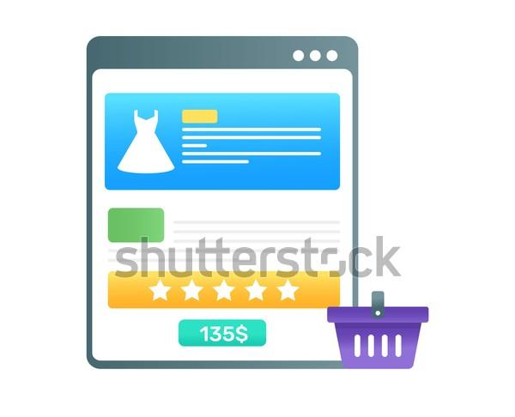
Product features
Articulate
Notes:
VO:
As the name indicates, it is the essential details of the product that differentiate them from other products and give them a unique representation.
GD notes:
Show the image, ref id:1960207948
@essential details…. Highlight the blue box
@diffrentiate…… highlight the five stars

Slide 52
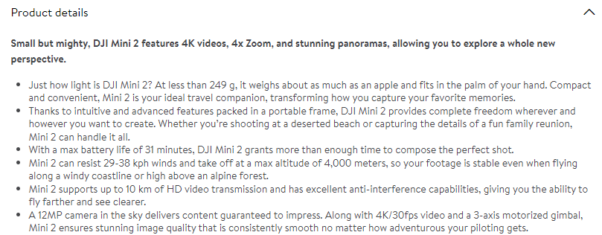
Product features
Articulate
OST Added
List the features in bullet points
Notes:
VO:
When writing the features, list them as bullet points. List the important features in the first two points and mention the less important points.
Use 5 bullet points to mention the product features. If you fell like adding a little more, make you do not go more than 6 points
GD notes:
Show the image
@bullet points…. Highlight the bullets
@first two points… highlight the first two points

Slide 53
Product features
Do not add promotional information in the features list.
Articulate
Do not add your email ID as a feature.
Do not add subjective words when mentioning the product details.
Notes:
VO:
Do not add promotional information in the features list.
Do not add your email ID as a feature.
Do not add subjective words when mentioning the product details.
GD notes:
Retain the previous screen as bg,
Show the OST in sync with the audio

Slide 54


Product ratings
Video
OST Added
Product review impacts the rating
Notes:
VO:
The review of a product has an immense impact on the ratings. They go hand in hand with each other.
GD note:
Animate the image as slide the reviews in the screen
@impact on ratings….. Show the ratings image and animate the hand placing the star
Ref id: 1187032627 (remove the character above the screen)
Ref id: 663157873

Slide 55

Product ratings
Video
OST Added
Focus on good customer service
Notes:
VO:
Thus, if you want to make sure that your rating is high then you should focus not only on producing quality products but also having good customer service and help them solve their problems they might be facing as well.
GD notes:
Animate the image and two characters talking in the call happily
Ref id: 1746333059

Slide 56


Product ratings
Video
Notes:
VO:
Suppose your product is struggling with low ratings, here are some tips to help improve the situation
GD note:
Animate the image as the men struggling to pull the arrow.
Ref id: 1893190741

Slide 57


Product ratings
Video
OST Added
Find a solution to the common problem the customers are facing
Notes:
VO notes:
Be on the lookout for patterns in the reviews. Find the common problem the customers are facing and find a solution to it
GD notes:
Animate the man looking the reviews
Ref id:1549080992, 1926116813(use low rating like 3 to 1)

Slide 58

Product ratings
Write a review
Video
Notes:
VO notes:
Ask for a ‘Review in Your Product Package’
GD notes:
Show the image and animate the callouts
Ref id: 1790808362

Slide 59

Product ratings
Video
OST Added
Respond to a concern as soon as possible
Notes:
VO notes:
Respond to a concern as soon as possible
GD notes:
Show the image and animate as the person in the screen
Ref id: 1441674362

Slide 60

Examples of good and bad listing
Good
Bad
Video
Notes:
VO:
To conclude let us see some good and bad examples of product listing
GD notes:
Display the image @”conclude”
Animate the people in the image @” good and bad example”

Slide 61
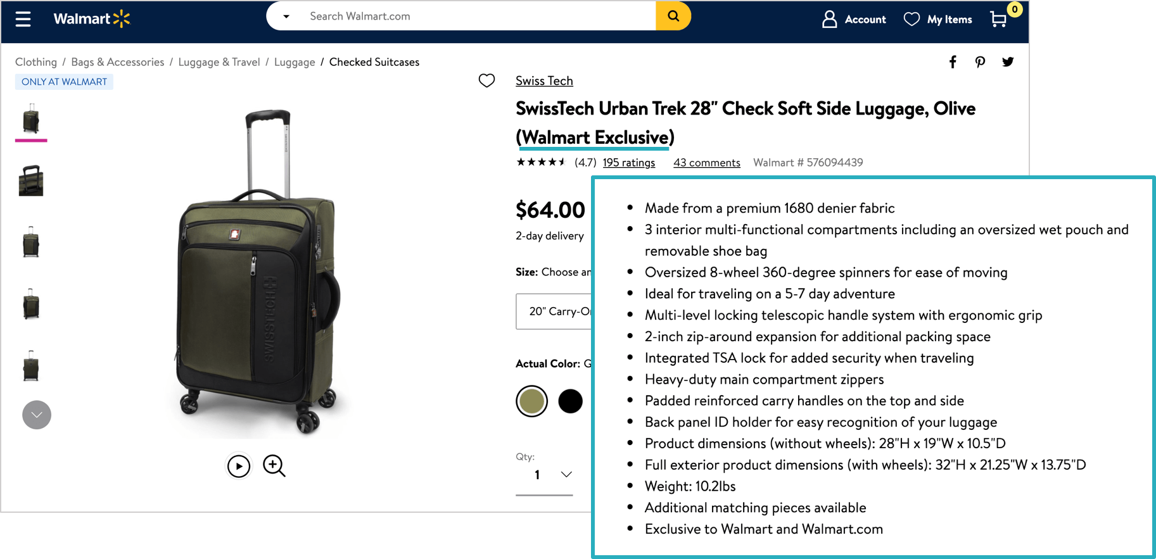
Examples of good and bad listing
Articulate
Notes:
VO:
In this example, the company SwissTech clearly mentions all the key parameters such as product title, product description, product features, ratings, and variants. This is all reinforced by pictures showing the bag at each angle.
GD notes:
@” swisstech” display the image of the product
@”key parameters” display an arrow on the product title ( In bold at the top)
@” product description” display an arrow on the product description.

Slide 62
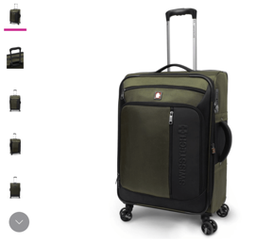
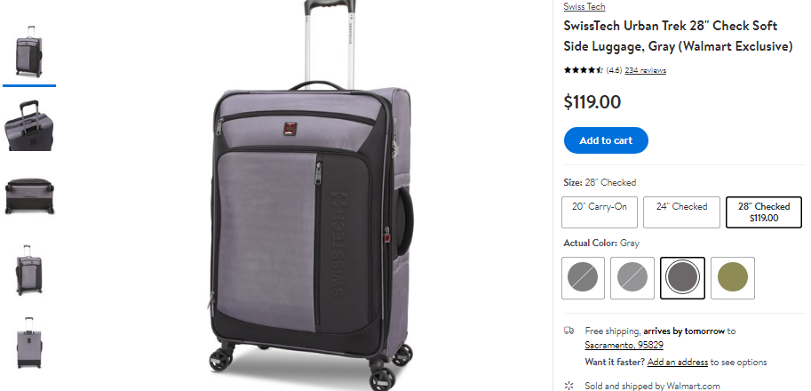
Examples of good and bad listing
$64.00
Articulate
$64.00
Notes:
VO:
Sizes are described as “checked” or “carry on” so that buyers know exactly which model they’ll need
GD notes:
@”sizes” display the image of the product
@”checked” display an arrow on the size options in the image.

Slide 63
Examples of good and bad listing
$64.00
Articulate
$64.00
Notes:
VO:
The cherry on top: This SwissTech bag is exclusive to Walmart, which means buyers don’t have to worry about scouring the internet to find a better price for the bag; If they like what they see, they should go ahead and pull the trigger.
GD notes:
Show the image and highlight the word ‘Walmart Exclusive’

Slide 64
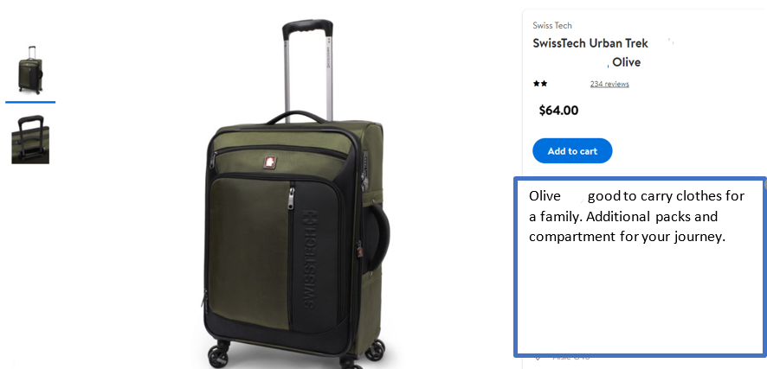
Examples of good and bad listing
Articulate
Notes:
VO:
In this example, there are very few information regarding the product title, description, features, variations, etc. There is less information on the product description, and it is in a paragraph rather than displayed as bullet points
GD notes:
Display an incorrect sign on the product image for the entire VO
@”example” view the image of the product on the screen
@information display arrows on the product title and product description

Slide 65

Conclusion
Video
OST Added
Walmart Listing Quality Dashboard: Allows you to track and improve your listing
Notes:
VO:
The Walmart Listing Quality dashboard allows you to track and improve your listing. Ensure to keep a check on your score to find improvement areas.
GD notes:
Show and animate the image
Ref id: 1350421637

Slide 66

Provide engaging, informative, and convincing product description, images for the buyers to purchase your products
Choose a short, concrete title that defines the product in one line
Provide number of variants and high-quality images for your products to attract the customers
Include key features and benefits that differentiate from other products to attract customers to buy your product
New Slide
Have a good customer service and respond quickly to get positive reviews which has an immense impact on the ratings
Notes:
VO:
Let us see the key takeaways from this module.
Provide engaging, informative, and convincing product description, images for the buyers to purchase your products.
Choose a short, concrete title that defines the product in a single line.
Provide number of variants and high-quality images for your products to attract the customers.
Include key features and benefits that differentiate from other products to attract customers to buy your product.
Have a good customer service and respond quickly to get positive reviews which has an immense impact on the ratings.
GD notes:
Animate and show the infographic in sync with the VO
Ref id: 243909043

Slide 67
Conclusion
Hope you have a better understanding on product listing now, Michael.
Video
Notes:
VO:
Hope you have a better understanding on product listing now, Michael.
GD note:

Slide 68
Conclusion
Thank you very much John! It was very informative, and I learnt a lot from today.
Video
Notes:
VO:
Thank you very much John! It was very informative, and I learnt a lot from today.
GD note:
Animate they are talking and show the callout in sync with the VO

Slide 69
Conclusion
All the best on your venture with Walmart!
Video
Notes:
VO:
All the best on your venture with Walmart.
GD note:
Animate as they are talking and shaking hands at last

Slide 70
Articulate
Thank You !!!!

